Slide 1
STAT 5340 Statistical Analysis I
Inference for Multiple Samples

Slide 2
Two Sample Problems
Consider 2 Types of Two Sample Problems:
Paired (Dependent) Samples
- These samples are “linked “ in some way by observation
- Results for same individual, same location, same object, etc.
- Samples will Always be Same Size
Independent Samples
- No obvious “link” across samples
- Each group comprised of results for entirely different
individuals, locations, objects, etc.
- Samples Not Necessarily of Same Size

Slide 3
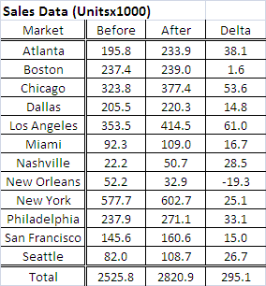
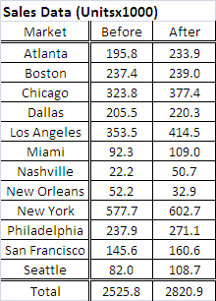
Paired Sample Data
Suppose we work for an advertising firm, and have prepared a new
marketing campaign for one of our national clients.
Before running the campaign nationwide, we want to know if it will
have sufficient impact to justify such an expense.
Consequently, we run the campaign in 12 selected test markets
around the country.
The data we have is Sales data for the two weeks prior to running
the new ads in each market, and Sales data for the two weeks
after running the ads.
With paired data such as this, we generally consider the difference in results for each observation.
“Link” is same Market
Now the Research Hypothesis becomes:
H₁: μ_{Delta} > 0
and the corresponding Null Hypothesis is:
H₀: μ_{Delta} = 0

Slide 4

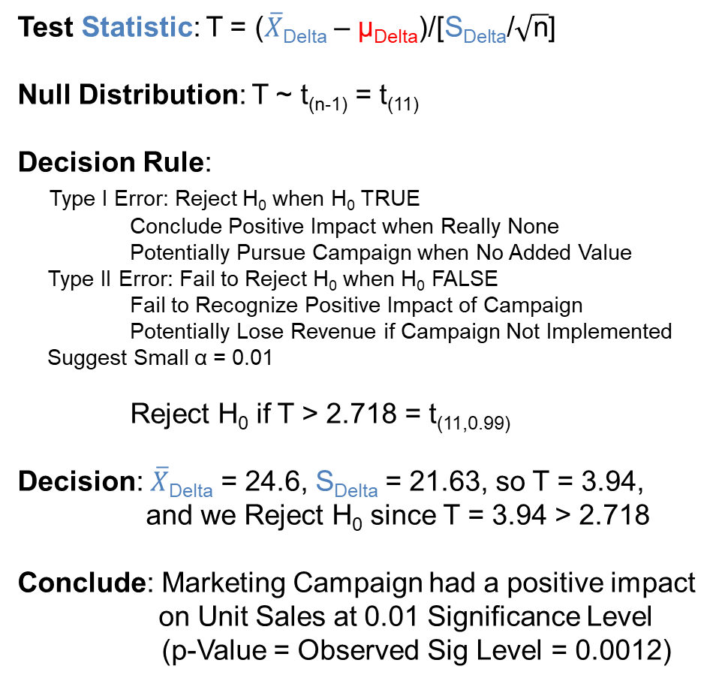
Paired Sample Data
Test Statistic: T = ($\overline{X}$_{Delta} – μ_{Delta})/[S_{Delta}/$\sqrt{\text{n}}$]
Null Distribution: T ~ t_{(n-1)} = t₍₁₁₎
Decision Rule:
Type I Error: Reject H₀ when H₀ TRUE
Conclude Positive Impact when Really None
Potentially Pursue Campaign when No Added Value
Type II Error: Fail to Reject H₀ when H₀ FALSE
Fail to Recognize Positive Impact of Campaign Potentially Lose Revenue if Campaign Not Implemented
Suggest Small α = 0.01
Reject H₀ if T > 2.718 = t_{(11,0.99)}
Decision: $\overline{X}$_{Delta} = 24.6, S_{Delta} = 21.63, so T = 3.94,
and we Reject H₀ since T = 3.94 > 2.718
Conclude: Marketing Campaign had a positive impact
on Unit Sales at 0.01 Significance Level
(p-Value = Observed Sig Level = 0.0012)
n = 12 < 30 (small)
σ Unknown, so T

Slide 5
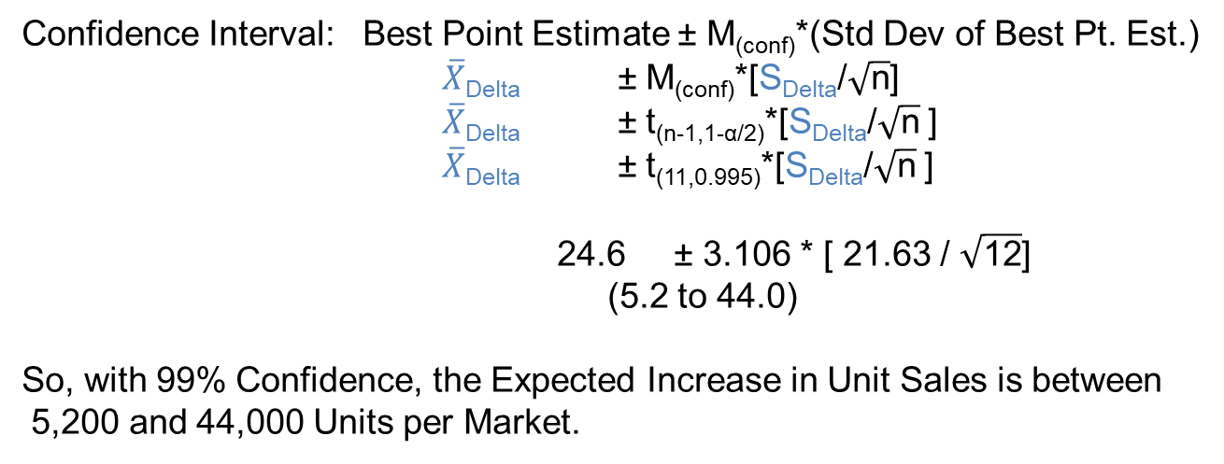
Paired Sample Data
So it appears the Marketing Campaign Has the potential to Increase Unit Sales,
but by how much?
Confidence Interval: Best Point Estimate ± M_{(conf)}*(Std Dev of Best Pt. Est.)
$\overline{X}$_{Delta} ± M_{(conf)}*[S_{Delta}/$\sqrt{\text{n}}$]
$\overline{X}$_{Delta} ± t_{(n-1,1-α/2)}*[S_{Delta}/$\sqrt{\text{n}}$]
$\overline{X}$_{Delta} ± t_{(11,0.995)}*[S_{Delta}/$\sqrt{\text{n}}$]
24.6 ± 3.106 * [ 21.63 / $\sqrt{\text{12}}$]
(5.2 to 44.0)
So, with 99% Confidence, the Expected Increase in Unit Sales is between
5,200 and 44,000 Units per Market.
n = 12 < 30 (small)
σ Unknown, so T
α = 0.01, α/2 = 0.005,
so 1 – α/2 = 0.995
Does this tell us all we need to know to make a decision here?
For the 12 Markets tested, the Increases above represent a ~2.5% to ~20.9% in
Unit Sales, but if the Marketing Campaign needs to Increase Sales by 25% in
order to provide a return greater then the firm’s cost of capital, then it is likely
the money for the campaign could be better invested elsewhere.
Important Point: Statistical Significance Does NOT Imply Practical Significance

Slide 6
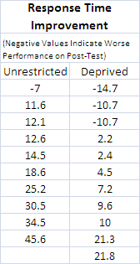
Independent Samples Data
In many situations, we do not have, or are unable to obtain paired results.
Consider a Sleep Deprivation study.
There were two sample groups involved:
Group 1: Sleep Deprived & Group 2: Unrestricted Sleep
Group 1 had 11 individuals & Group 2 had 10 individuals
No clear, obvious “link” between individuals across groups, so considered
Independent
The measurement of interest was
Response Time Improvement after 3 days
- Group 1 was Deprived of Sleep on 1st day after initial test
- Group 2 was allowed Unrestricted Sleep all 3 days
Question of Interest is Whether or Not Sleep Deprivation
Effects Linger for Multiple Days, so
Research Hypothesis: μ_{Unrestricted} – μ_{Deprived} > 0
and
Null Hypothesis: μ_{Unrestricted} – μ_{Deprived} = 0
Improvement Greater for
Unrestricted Sleep Group
No Difference in Improvement
Between Groups

Slide 7
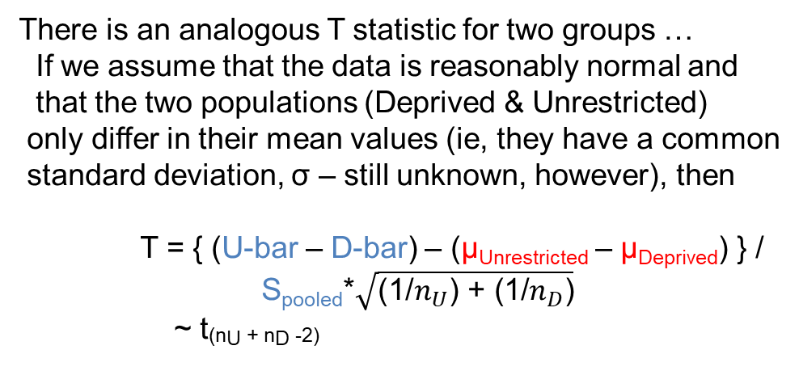
Independent Samples Data
Function of the Difference
In sample Averages
Test Statistic: U-bar – D-bar
Null Distribution: ?
T as given below
Difference in Sample Averages
n is small for both groups, as well as combined,
and there is no information about the value of σ,
for either group, or collectively – suggests we need
something similar to the T statistic we use for single
sample hypothesis testing.
There is an analogous T statistic for two groups …
If we assume that the data is reasonably normal and
that the two populations (Deprived & Unrestricted)
only differ in their mean values (ie, they have a common
standard deviation, σ – still unknown, however), then
T = { (U-bar – D-bar) – (μ_{Unrestricted} – μ_{Deprived}) } /
S_{pooled}*$\sqrt{\text{(1/}n_{U}\text{) + (1/}n_{D}\text{)}}$
~ t_{(nU + nD -2)}
NOTE: Will be Zero Under Null Model
S_{pooled} = $\sqrt{\text{[(}n_{U}\text{−1)}\text{S}\text{U}\text{2}\text{ + (}n_{D}\text{−1)}\text{S}\text{D}\text{2}\text{] / (}n_{U}\text{+}n_{D}\text{−2)}}$

Slide 8

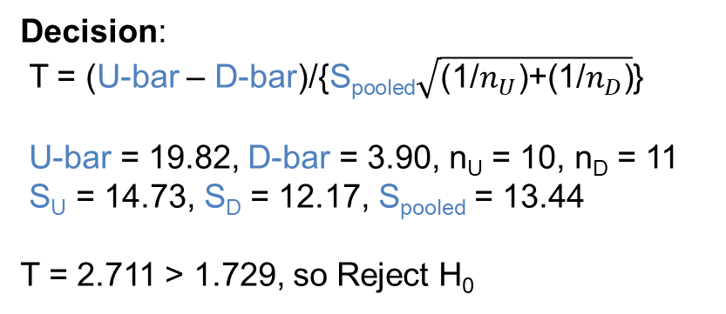
Independent Samples Data
Decision Rule:
Type I Error: Reject H₀ when H₀ TRUE
Conclude there are lingering effects of Sleep Deprivation when there are none
Type II Error: Fail to Reject H₀ when H₀ FALSE
Fail to recognize real lingering Sleep Deprivation effects
Suggest α = 0.05
Reject if T > 1.729 = t_{(19,0.95)}
NOTE: n_{U} + n_{D} -2 =
10 + 11 -2 = 19
Decision:
T = (U-bar – D-bar)/{S_{pooled}$\sqrt{\text{(1/}n_{U}\text{)+(1/}n_{D}\text{)}}$}
U-bar = 19.82, D-bar = 3.90, n_{U} = 10, n_{D} = 11
S_{U} = 14.73, S_{D} = 12.17, S_{pooled} = 13.44
T = 2.711 > 1.729, so Reject H₀
Conclude: There are lingering effects of Sleep
Deprivation even 3 days later
(p-Value = 0.0069)

Slide 9
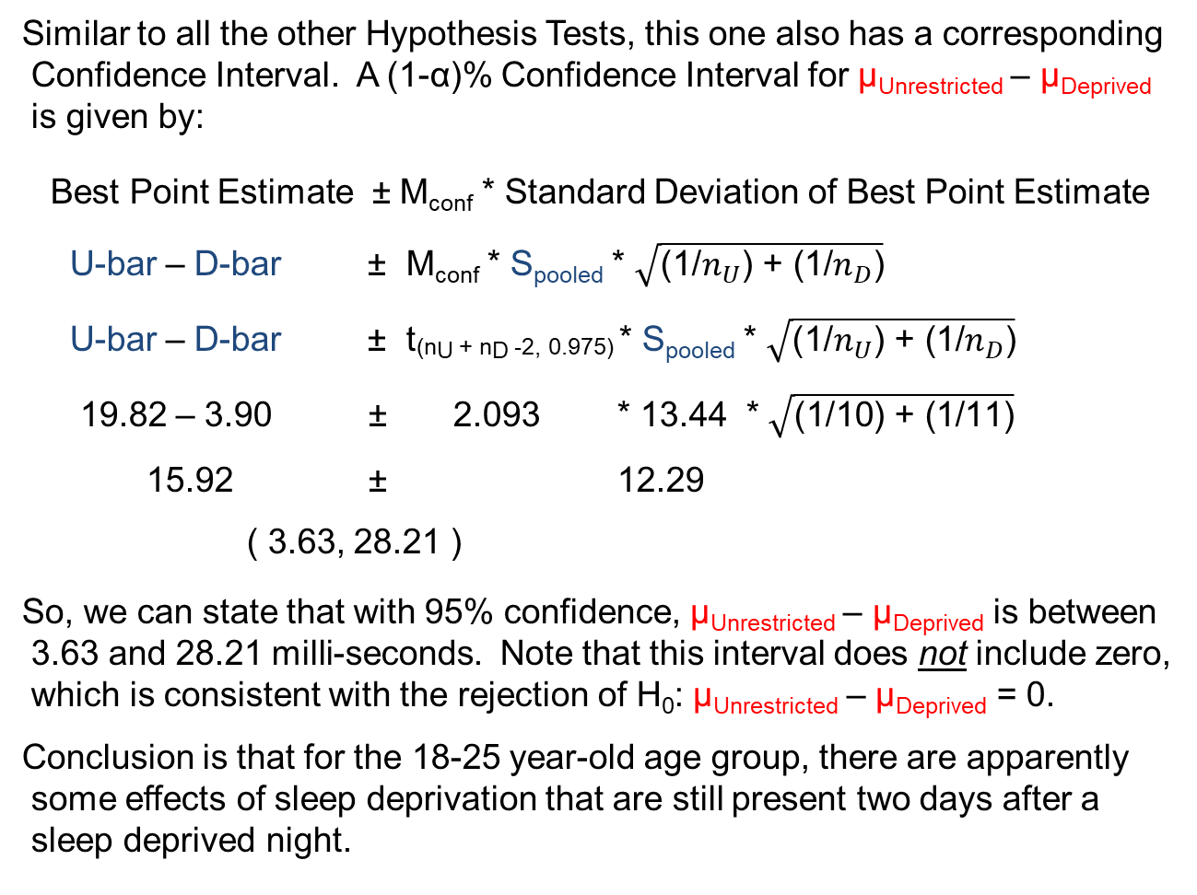
Independent Samples Data
Similar to all the other Hypothesis Tests, this one also has a corresponding
Confidence Interval. A (1-α)% Confidence Interval for μ_{Unrestricted} – μ_{Deprived}
is given by:
Best Point Estimate ± M_{conf} * Standard Deviation of Best Point Estimate
U-bar – D-bar ± M_{conf} * S_{pooled} * $\sqrt{\text{(1/}n_{U}\text{) + (1/}n_{D}\text{)}}$
U-bar – D-bar ± t_{(nU + nD -2, 0.975)} * S_{pooled} * $\sqrt{\text{(1/}n_{U}\text{) + (1/}n_{D}\text{)}}$
19.82 – 3.90 ± 2.093 * 13.44 * $\sqrt{\text{(1/}\text{10}\text{) + (1/}\text{11}\text{)}}$
15.92 ± 12.29
( 3.63, 28.21 )
So, we can state that with 95% confidence, μ_{Unrestricted} – μ_{Deprived} is between
3.63 and 28.21 milli-seconds. Note that this interval does not include zero,
which is consistent with the rejection of H₀: μ_{Unrestricted} – μ_{Deprived} = 0.
Conclusion is that for the 18-25 year-old age group, there are apparently
some effects of sleep deprivation that are still present two days after a
sleep deprived night.

Slide 10
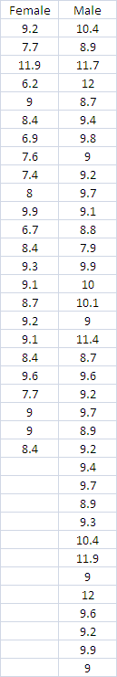
Comparison of Two Means
Consider a company that annually distributes bonuses to its employees, but uses a rather involved method to determine the size of the bonus (as a percentage of each employee’s regular salary) for each individual.
The primary factor in the method is the evaluation of the employee’s direct supervisor, and the Human Resources department is concerned that male employees are being routinely rated higher than female employees with a resultant difference in annual bonus pay.
To assess this concern, the HR group randomly sampled some recent bonus pay percentages for a number of employees of each gender.
What might be a reasonable first step?
So, the graphs alone suggest that % Bonus Pay is higher for male employees …

Slide 11
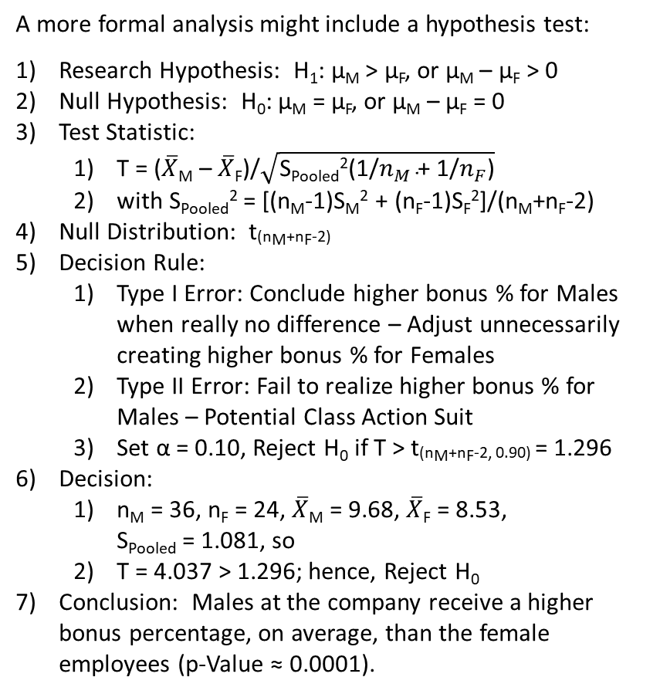
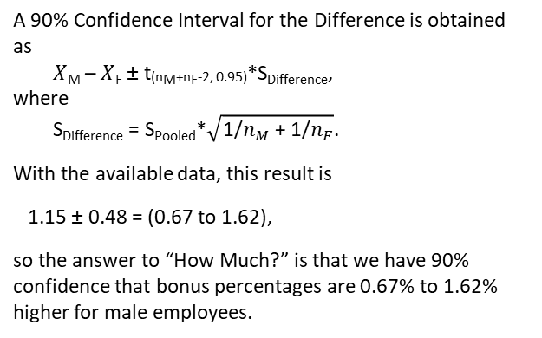
Comparison of Two Means
A more formal analysis might include a hypothesis test:
Research Hypothesis: H₁: μ_{M} > μ_{F}, or μ_{M} – μ_{F} > 0
Null Hypothesis: H₀: μ_{M} = μ_{F}, or μ_{M} – μ_{F} = 0
Test Statistic:
T = ($\overline{X}$_{M} – $\overline{X}$_{F})/$\sqrt{\text{S}\text{Pooled}\text{2}\text{(1/}n_{M}\text{ + 1/}n_{F}\text{)}}$
with S_{Pooled}² = [(n_{M}-1)S_{M}² + (n_{F}-1)S_{F}²]/(n_{M}+n_{F}-2)
Null Distribution: t_{(nM+nF-2)}
Decision Rule:
Type I Error: Conclude higher bonus % for Males when really no difference – Adjust unnecessarily creating higher bonus % for Females
Type II Error: Fail to realize higher bonus % for Males – Potential Class Action Suit
Set α = 0.10, Reject H₀ if T > t_{(nM+nF-2, 0.90)} = 1.296
Decision:
n_{M} = 36, n_{F} = 24, $\overline{X}$_{M} = 9.68, $\overline{X}$_{F} = 8.53, S_{Pooled} = 1.081, so
T = 4.037 > 1.296; hence, Reject H₀
Conclusion: Males at the company receive a higher bonus percentage, on average, than the female employees (p-Value ≈ 0.0001).
NOTE: There is an implicit assumption being made here that the variance for the Male and Female bonus percentages are the same value (ie, σ_{M}² = σ_{F}²). This may or may not be reasonable. If not, then the test needs to be modified.
Rejection Region
P[t₍₅₉₎ > 1.296] = 0.10
A 90% Confidence Interval for the Difference is obtained as
$\overline{X}$_{M} – $\overline{X}$_{F} ± t_{(nM+nF-2, 0.95)}*S_{Difference},
where
S_{Difference} = S_{Pooled}*$\sqrt{\text{1/}n_{M}\text{ + 1/}n_{F}}$.
With the available data, this result is
1.15 ± 0.48 = (0.67 to 1.62),
so the answer to “How Much?” is that we have 90% confidence that bonus percentages are 0.67% to 1.62% higher for male employees.
Clearly, this result is unsatisfactory, we would want to know how much higher.

Slide 12
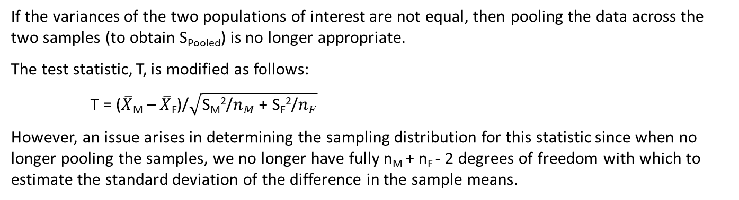
Comparison of Two Means
If the variances of the two populations of interest are not equal, then pooling the data across the two samples (to obtain S_{Pooled}) is no longer appropriate.
The test statistic, T, is modified as follows:
T = ($\overline{X}$_{M} – $\overline{X}$_{F})/$\sqrt{\text{S}\text{M}\text{2}\text{/}n_{M}\text{ + }\text{SF}\text{2}\text{/}n_{F}}$
However, an issue arises in determining the sampling distribution for this statistic since when no longer pooling the samples, we no longer have fully n_{M} + n_{F} - 2 degrees of freedom with which to estimate the standard deviation of the difference in the sample means.
So … while T can still be approximated by a student’s t distribution, what degrees of freedom (df) are appropriate?
One common, and easy approach is to use
df = min(n_{M} - 1, n_{F} - 1)
Since we know there are n_{M} - 1 and n_{F} - 1 df for S_{M}² and S_{F}², respectively, choosing the minimum of these two values provides a conservative approach (recall, lower df results in heavier tails, so critical values and p-values will be larger in magnitude, and rejection of H₀ less likely).
A more accurate approach is to use
df = [(A + B)²/{A²/(n_{M}-1) + B²/(n_{F}-1)}], where A = S_{M}²/n_{M}, B = S_{F}²/n_{F}, and [x] = greatest integer in x
This will result in a value between min(n_{M} - 1, n_{F} - 1) and n_{M} + n_{F} - 2.

Slide 13
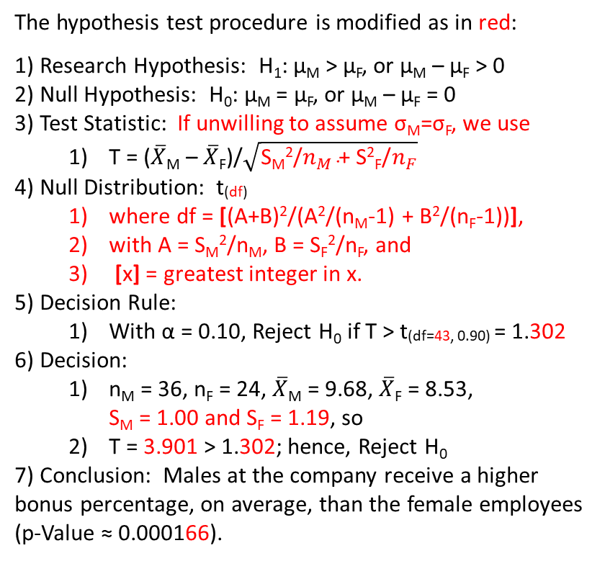
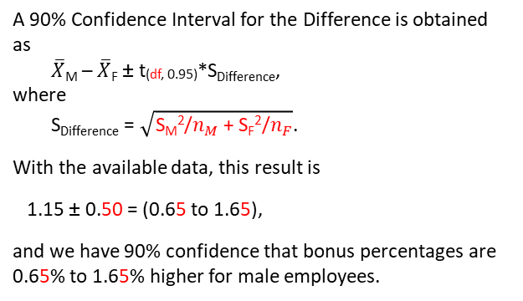
Comparison of Two Means
The hypothesis test procedure is modified as in red:
Research Hypothesis: H₁: μ_{M} > μ_{F}, or μ_{M} – μ_{F} > 0
Null Hypothesis: H₀: μ_{M} = μ_{F}, or μ_{M} – μ_{F} = 0
Test Statistic: If unwilling to assume σ_{M}=σ_{F}, we use
T = ($\overline{X}$_{M} – $\overline{X}$_{F})/$\sqrt{\text{S}\text{M}\text{2}\text{/}n_{M}\text{ + }\text{S}\text{2}\text{F}\text{/}n_{F}}$
Null Distribution: t_{(df)}
where df = [(A+B)²/(A²/(n_{M}-1) + B²/(n_{F}-1))],
with A = S_{M}²/n_{M}, B = S_{F}²/n_{F}, and
[x] = greatest integer in x.
Decision Rule:
With α = 0.10, Reject H₀ if T > t_{(df=43, 0.90)} = 1.302
Decision:
n_{M} = 36, n_{F} = 24, $\overline{X}$_{M} = 9.68, $\overline{X}$_{F} = 8.53, S_{M} = 1.00 and S_{F} = 1.19, so
T = 3.901 > 1.302; hence, Reject H₀
Conclusion: Males at the company receive a higher bonus percentage, on average, than the female employees (p-Value ≈ 0.000166).
So, most analysts simply assume unequal variances across groups, because if TRULY same, results will be very similar if had assumed same.
Rejection Region
P[t₍₄₃₎ > 1.302] = 0.10
A 90% Confidence Interval for the Difference is obtained as
$\overline{X}$_{M} – $\overline{X}$_{F} ± t_{(df, 0.95)}*S_{Difference},
where
S_{Difference} = $\sqrt{\text{S}\text{M}\text{2}\text{/}n_{M}\text{ + }\text{SF}\text{2}\text{/}n_{F}}$.
With the available data, this result is
1.15 ± 0.50 = (0.65 to 1.65),
and we have 90% confidence that bonus percentages are 0.65% to 1.65% higher for male employees.
To borrow from a famous bard, is this “much ado about nothing”?
Well, in this case, this is close to valid, as there is not much difference in variation across the groups.

Slide 14
Comparison of Two Means
HR Data:
R Code:
> hr_data = read.csv("HR Data.csv")
> hr_data
Female Male
1 9.2 10.4
2 7.7 8.9
3 11.9 11.7
4 6.2 12.0
5 9.0 8.7
6 8.4 9.4
7 6.9 9.8
8 7.6 9.0
9 7.4 9.2
10 8.0 9.7
11 9.9 9.1
12 6.7 8.8
13 8.4 7.9
14 9.3 9.9
15 9.1 10.0
16 8.7 10.1
17 9.2 9.0
18 9.1 11.4
19 8.4 8.7
20 9.6 9.6
21 7.7 9.2
22 9.0 9.7
23 9.0 8.9
24 8.4 9.2
25 NA 9.4
26 NA 9.7
27 NA 8.9
28 NA 9.3
29 NA 10.4
30 NA 11.9
31 NA 9.0
32 NA 12.0
33 NA 9.6
34 NA 9.2
NA 9.9
NA 9.0
Assuming Equal Variances:
> female = hr_data[,1]
> male = hr_data[,2]
>
> t.test(male, female, alternative = "greater", var.equal = TRUE)
Two Sample t-test
data: male and female
t = 4.0367, df = 58, p-value = 8.044e-05
alternative hypothesis: true difference in means is greater than 0
95 percent confidence interval:
0.6738034 Inf
sample estimates:
mean of x mean of y
9.683333 8.533333
NOTE: One-sided options (eg, “greater”) produce one-sided confidence bounds. To obtain two-sided confidence bounds, use: “two.sided” (default).
NOT Assuming Equal Variances:
> t.test(male, female, alternative = "greater")
Welch Two Sample t-test
data: male and female
t = 3.9013, df = 43.587, p-value = 0.0001635
alternative hypothesis: true difference in means is greater than 0
95 percent confidence interval:
0.6546071 Inf
sample estimates:
mean of x mean of y
9.683333 8.533333

Slide 15
Comparison of Two Variances
So, what about a statistical comparison of two population variances (or standard deviations)?
Can we test to see if the assumption of equal variances is reasonable or not?
Research Hypothesis: H₁: σ_{M}² ≠ σ_{F}²
Null Hypothesis: H₀: σ_{M}² = σ_{F}²
Test Statistic: ?
F = S_{F}²/S_{M}², ratio of Sample Variances
S_{F}² = Sample Variance for Females
S_{M}² = Sample Variance for Males
Generally, put Larger Sample Variance in Numerator, but not necessary since this is a two-tailed hypothesis test.
Null Distribution: ?
Under H₀, F ~ F_{(nF-1, nM-1)}
F distributions indexed by 2 degrees of freedom values (numerator & denominator)
Requires samples to be
Independent
Random
From a Normal Distribution
Decision Rule:
w/ α=0.05, Reject H₀ if
F < 0.45 or F > 2.07
Decision:
S_{F}² = 1.41, S_{M}² = 1.01
F = 1.40, so Fail to Reject H₀
Conclusion: Insufficient evidence to indicate unequal variances (p-Value = 0.181)
Critical Region – Low
P[F < 0.45] = α/2 = 0.025
p-Value
P[F > 1.40] = 0.181
Critical Region – High
P[F > 2.07] = α/2 = 0.025
NOTE: Frequently, for two-sided cases, software packages will report twice the value above, or a p-Value = 0.362.
However, in this case, a more appropriate consideration of the lower tail would be to calculate P[F < 1/1.40] = 0.200, then add this to the above to get a p-Value = 0.381.

Slide 16
Differences Between Two Standard Deviations
In the Sleep Deprivation study, when evaluating the means of the two groups, we pooled the information on variation by calculating a pooled standard deviation. The inherent assumption here was that the two samples came from populations with the same (or at least very nearly the same) variance. We can check this assumption:
Research Hypothesis: H₁: σ₁ ≠ σ₂
Null Hypothesis: H₀: σ₁ = σ₂
Test Statistic: F = [S₁²/σ₁²]/[S₂²/σ₂²]
Null Distribution: F_{(n1-1, n2-1)}
Provided both populations follow normal distributions
Decision Rule: Reject H₀ if
F < F_{(n1-1, n2-1, α/2)} or F > F_{(n1-1, n2-1, 1-α/2)},
with α=0.05, n₁ = 10, n₂ = 11:
F < 0.25 or F > 3.78
α/2 = 0.025
Decision: with S₁ = 14.73 & S₂ = 12.17
Sleep Deprivation Study data
F = (14.73/12.17)² = 1.465
Conclusion: Data do not present sufficient evidence to conclude different variances
for the two groups (p-Value ≈ 0.280).

Slide 17
Comparison of Two Variances
The assumption of Normally distributed populations being involved is an important one for use of the F-Distribution to make inferences about the two respective variances.
Consequently, it is generally desirable to evaluate this assumption prior to using this approach, or to use a different approach.
Evaluation for HR Data:
Conclusion:
Insufficient evidence to indicate Female results are not normally distributed.
(So assumption of normality considered reasonable.)
Conclusion:
Evidence suggests Male results are not normally distributed.
(So assumption of normality considered unreasonable.)
F-Test may not have generated valid conclusion.

Slide 18

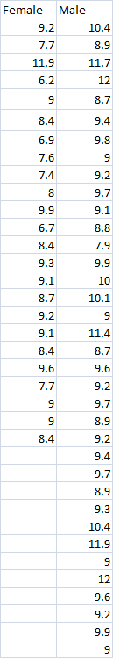
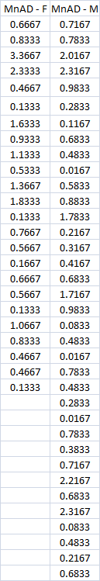
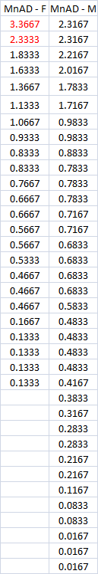
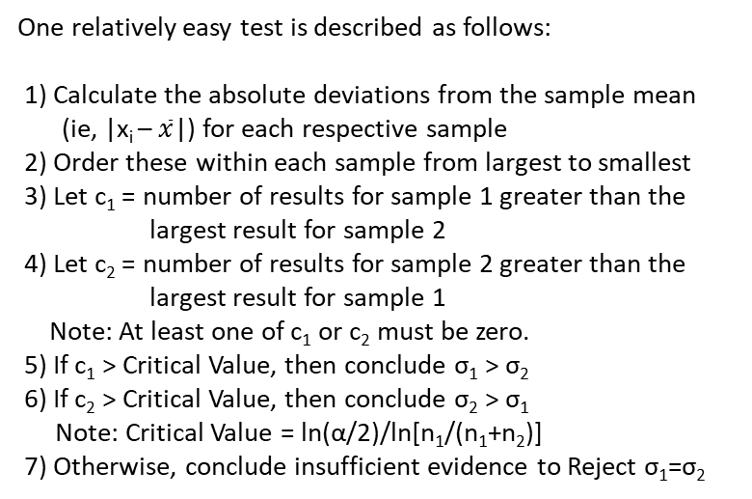
Comparison of Two Variances
So … what do we do now?
Consider a different approach that does not depend on Normality.
Sorted Mean Absolute Deviations
Mean Absolute Deviations
One relatively easy test is described as follows:
1) Calculate the absolute deviations from the sample mean
(ie, |x_{i} – $\overline{x}$|) for each respective sample
2) Order these within each sample from largest to smallest
3) Let c₁ = number of results for sample 1 greater than the
largest result for sample 2
4) Let c₂ = number of results for sample 2 greater than the
largest result for sample 1
Note: At least one of c₁ or c₂ must be zero.
5) If c₁ > Critical Value, then conclude σ₁ > σ₂
6) If c₂ > Critical Value, then conclude σ₂ > σ₁
Note: Critical Value = ln(α/2)/ln[n₁/(n₁+n₂)]
7) Otherwise, conclude insufficient evidence to Reject σ₁=σ₂
Data
For the HR Data …
c₁ = c_{F} = 2 (and c₂ = c_{M} = 0)
Critical Value = 4.02 (w/ α=0.05)
Conclude: Insufficient evidence to indicate
σ_{F} ≠ σ_{M}.
NOTE: This is consistent with the F-Test result.

Slide 19

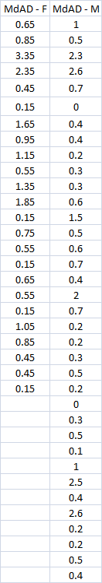
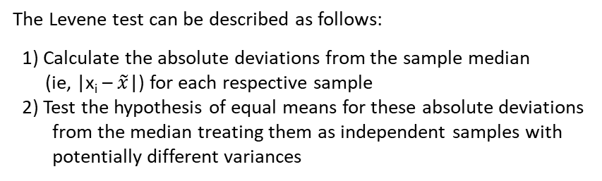
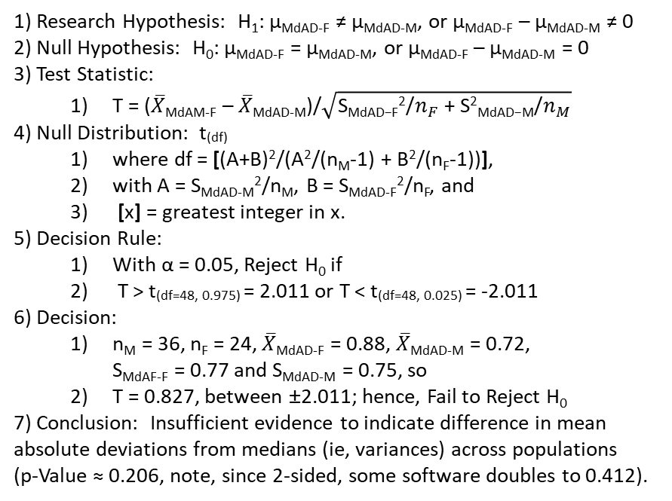
Comparison of Two Variances
Another commonly used alternative approach that does not require the assumption of Normality is the Levene-Brown-Forsythe test.
The Levene test can be described as follows:
1) Calculate the absolute deviations from the sample median
(ie, |x_{i} – $\tilde{x}$|) for each respective sample
2) Test the hypothesis of equal means for these absolute deviations from the median treating them as independent samples with potentially different variances
Median Absolute Deviations
Data
1) Research Hypothesis: H₁: μ_{MdAD-F} ≠ μ_{MdAD-M}, or μ_{MdAD-F} – μ_{MdAD-M} ≠ 0
2) Null Hypothesis: H₀: μ_{MdAD-F} = μ_{MdAD-M}, or μ_{MdAD-F} – μ_{MdAD-M} = 0
3) Test Statistic:
T = ($\overline{X}$_{MdAM-F} – $\overline{X}$_{MdAD-M})/$\sqrt{\text{S}\text{MdAD}\text{−}\text{F}\text{2}\text{/}n_{F}\text{ + }\text{S}\text{2}\text{MdAD}\text{−}\text{M}\text{/}n_{M}}$
4) Null Distribution: t_{(df)}
where df = [(A+B)²/(A²/(n_{M}-1) + B²/(n_{F}-1))],
with A = S_{MdAD-M}²/n_{M}, B = S_{MdAD-F}²/n_{F}, and
[x] = greatest integer in x.
5) Decision Rule:
With α = 0.05, Reject H₀ if
T > t_{(df=48, 0.975)} = 2.011 or T < t_{(df=48, 0.025)} = -2.011
6) Decision:
n_{M} = 36, n_{F} = 24, $\overline{X}$_{MdAD-F} = 0.88, $\overline{X}$_{MdAD-M} = 0.72, S_{MdAF-F} = 0.77 and S_{MdAD-M} = 0.75, so
T = 0.827, between ±2.011; hence, Fail to Reject H₀
7) Conclusion: Insufficient evidence to indicate difference in mean absolute deviations from medians (ie, variances) across populations (p-Value ≈ 0.206, note, since 2-sided, some software doubles to 0.412).
NOTE: The conclusion is still consistent with the other approaches.

Slide 20
Comparison of Two Variances
HR Data: Test for Equal Variances
MINITAB: Stat → Basic Statistics → 2 Variances
What are “Bonferroni” confidence intervals?
What is a confidence interval?
Test for Equal Variances: Female, Male
95% Bonferroni confidence intervals for standard deviations
N Lower StDev Upper
Female 24 0.892753 1.18896 1.75726
Male 36 0.791041 1.00385 1.36343
F-Test (Normal Distribution)
Test statistic = 1.40, p-value = 0.358
Levene's Test (Any Continuous Distribution)
Test statistic = 0.69, p-value = 0.408
Test for Equal Variances for Female, Male
Recall: A (1-α)% Confidence Interval implies the parameter of interest will be in the interval (1-α)% of the time such an interval is obtained.
Hence, α% of the time such intervals will fail to include the parameter of interest.
Now, two (1-α)% confidence intervals obtained from independent samples from two different populations will each fail to include their respective parameters of interest α% of the time.
Let A = Event that the 1st Interval Does Not Include its respective Parameter, then P[A] = α
Let B = Event that the 2nd Interval Does Not Include its respective Parameter, then P[B] = α
The probability that at least one of the intervals fails to include its respective parameter is P[A or B], so by the Compliment Rule, the probability that both intervals INCLUDE their respective parameters is 1 – P[A or B], but we know from the Additive Rule that
1 - P[A or B] = 1 – {P[A] + P[B] – P[A and B]}
= 1 – P[A] – P[B] + P[A and B]
> 1 – P[A] – P[B] = 1 – 2α, Bonferroni’s Inequality.
Hence, with α=0.05, two independent 95% confidence intervals have at least a 90% probability of both including their respective parameters, and would be referred to as 90% “Bonferroni” confidence intervals.
The 95% “Bonferroni” confidence intervals at left are obtained by calculating individual 97.5% confidence intervals for each of the respective parameters (in this case, σ_{F} and σ_{M}).

Slide 21
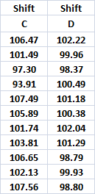
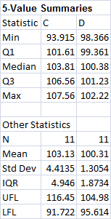
Independent Samples Data
Variances within Groups Unequal
Example: In Workshop 1, it was observed that in addition to having more variable gate widths, C Shift also appeared to have widths averaging higher than the other shifts. Consider comparing the averages observed on C & D Shifts (since D Shift was near target = 100nm).
Fairly obvious that variances within shifts are different, but F = S_{C}²/S_{D}² = 11.43 (p-Value≈0.0003); hence, using S_{Pooled} would be inappropriate when testing if μ_{C} > μ_{D}.
Research Hypothesis: μ_{C} > μ_{D}.
Null Hypothesis: μ_{C} = μ_{D}.
Test Statistic: T = (X-bar_{C} – X-bar_{D})/
sqrt(S_{C}²/n_{C} + S_{D}²/n_{D})
Null Distribution: t₍₁₂₎, where df from Welch
Decision Rule: Reject H₀ if T > t_{(12,α=0.05)} = 1.782
Decision: T = 2.031, so Reject H₀, and
Conclude: C Shift Gate Widths are Larger than those produced on D Shift (p-Value ≈ 0.0325).
A 90% confidence interval for how much larger is determined as:
(X-bar_{C} – X-bar_{D}) ± 1.782*sqrt(S_{C}²/n_{C} + S_{D}²/n_{D}) = 2.818 ± 1.782*1.388 = ( 0.35nm to 5.29nm) ,
so with 90% confidence, C Shift gate widths are between 0.35nm & 5.29nm larger than those produced on D Shift

Slide 22
Independent Samples Data
Differences Between Two Proportions
Suppose we work for a manufacturer of textiles, and suspect that one
of the machines producing fabric is producing more bolts with defects
than the others.
For a given time period, we sample 100 bolts from this machine and find
12 with defects.
During the same period, we also sample 200 bolts across the other
machines in operation and find 15 with defects.
Question here is whether or not the machine of interest is producing
a higher rate of defective bolts than the other machines, so ...
Research Hypothesis: π_{Defective,Machine} – π_{Defective,Others} > 0
and
Null Hypothesis: π_{Defective,Machine} – π_{Defective,Others} = 0
Defect Rate Greater for
Machine of Concern
No Difference in Defect Rates
Between Machine of Concern
and Others in Operation

Slide 23
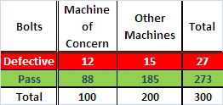
Independent Samples Data
Differences Between Two Proportions
Test Statistic: p_{Machine} – p_{Others}
Null Distribution: ?
Difference in Sample Proportions Defective
Recall that sample proportions are averages in disguise; hence, we can make use of the Central Limit Theorem, and
Under the Null Model, Defective Rates Same = π
p_{Machine} – p_{Others} ~ N( 0 , sqrt{π*(1-π)[1/n_{M} + 1/n_{O}]})
However, we do not know what under the null model would
be a common defect rate, π, so we will need to estimate it
from the available sample data.
Given the common defect rate under the null model, the
best estimate of π would be:
p_{Defect} = (n_{Defect,M} + n_{Defect,O}) / (n_{M} + n_{O})
= (12 + 15) / (100 + 200)
= 27 / 300
= 0.09
So … p_{Machine} – p_{Others} ~ N( 0 , sqrt{0.09*(1-0.09)[1/100 + 1/200]})
~ N( 0 , 0.035),
where π estimated by p_{Defect} = 0.09

Slide 24
Independent Samples Data
Differences Between Two Proportions
Decision Rule:
Type I Error: Reject H₀ when H₀ TRUE
Conclude the Machine is producing a higher rate of defectives when it is not
Type II Error: Fail to Reject H₀ when H₀ FALSE
Fail to recognize Machine is actually producing higher rate of defectives
Suggest α = 0.05
Reject if p_{Machine} – p_{Others} > z_{(0.95)}*0.035
1.645
= 0.058
Decision:
p_{Machine} – p_{Others} = (n_{Defect,M}/n_{M}) - (n_{Defect,O}/n_{O})
= 12/100 – 15/200
= 0.12 – 0.075
= 0.045 < 0.058, so
Fail to Reject H₀
α = 0.05
Critical
Value
= 0.058
Conclude: There is insufficient evidence to conclude Machine is producing higher defect rate than the Other machines in operation.
(p-Value = 0.0996)

Slide 25
Independent Samples Data
Differences Between Two Proportions
Again, just as with all the other Hypothesis Tests, this one also has a corresponding
Confidence Interval. A (1-α)% Confidence Interval for π_{Defective,Machine} – π_{Defective,Others}
is given by:
Best Point Estimate ± M_{conf} * Standard Deviation of Best Point Estimate
p_{Machine} – p_{Others} ± M_{(1-α/2)} * sqrt[p_{Defect}*(1-p_{Defect})*(1/n_{M}) + (1/n_{O})]
p_{Machine} – p_{Others} ± z_{(0.975)} * sqrt[p_{Defect}*(1-p_{Defect})*(1/n_{M}) + (1/n_{O})]
0.12 – 0.075 ± 1.96 * sqrt[0.09*(1-0.09)*(1/100) + (1/200)]
0.045 ± 0.069
( -0.024, 0.114 )
So, we can state that with 95% confidence, π_{Defective,Machine} – π_{Defective,Others} is between
-2.4% and 11.4%. Note that this interval does include zero, which is consistent
with the failure to reject H₀: π_{Defective,Machine} – π_{Defective,Others} = 0.
Conclusion is still that there is insufficient evidence in the sample data to conclude that the defect rate for the suspect machine is higher than that for the other machines in operation.

Slide 26
Independent Samples Data
Differences Between Two Proportions
What if we had Rejected H₀? Then using p_{Defect} in the calculation of the Standard Deviation of the Best Point Estimate (which amounts to “pooling” data) is no longer a valid approach – we have evidence the two proportions are different; hence their respective standard deviations are also different. In this case, a (1-α)% Confidence Interval for π_{Defective,Machine} – π_{Defective,Others} is given by:
Best Point Estimate ± M_{conf} * Standard Deviation of Best Point Estimate
p_{Machine} – p_{Others} ± z_{(1-α/2)} * sqrt[p_{Machine}*(1-p_{Machine})/n_{M} + p_{Others}*(1-p_{Others})/n_{O}]
Suppose we observed 16 Defective Bolts in the sample of 100 from the suspect Machine, then p_{Machine} = 0.16, and would lead to rejection of H₀, then 95% CI would be:
p_{Machine} – p_{Others} ± z_{(0.975)} * sqrt[p_{Machine}*(1-p_{Machine})/n_{M} + p_{Others}*(1-p_{Others})/n_{O}]
0.16 – 0.075 ± 1.96 * sqrt[0.16*(1-0.16)/100) + 0.075*(1-0.075)/200)]
0.085 ± 0.081
( 0.004, 0.166 )
Then we could state that with 95% confidence, π_{Defective,Machine} – π_{Defective,Others} is between 0.4% and 16.6%. Note that this interval does not include zero, which is consistent with rejection of H₀: π_{Defective,Machine} – π_{Defective,Others} = 0.
Conclusion would now be that the defect rate for the suspect machine is 0.4% to 16.6% higher (with 95% confidence) than that for the other machines in operation.

Slide 27
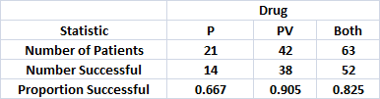
Comparison of Two Proportions
There is a requirement for the normal approximation to be valid in the comparison of proportions: the expected number of results within each of the table “cells” should be larger than 5.
This is equivalent to min[n₁, n₂]*min[p_{Tot}, (1-p_{Tot})] > 5.
For the textile machine problem, the value of min[n_{M}, n_{O}] = 100 is sufficiently large that this not an issue [min(p_{Tot}, 1-p_{Tot}) = 0.09, and 0.09*100 = 9].
However, consider a clinical trial of two drug therapies for leukemia: P and PV, where 21 patients were assigned to P and 42 were assigned to drug PV, with the following results:
Here,
min[n_{P}, n_{PV}] = 21
and
min[p_{Tot}, 1-p_{Tot}] = 0.175,
so
21*0.175 ≈ 3.67 < 5
So, how can we test whether PV is in fact a more successful treatment than drug P?

Slide 28
Comparison of Two Proportions
Commonly, Fisher’s Exact Test is utilized.
The idea is that if both drugs are equally successful in treating leukemia, then the total number of successes (here, this is 52) should be distributed across the drugs reasonably close to proportionally to the respective numbers of patients treated with each of the drugs.
So, as the number of successes increases for the group with the highest number of successes, this would suggest that the true probability of success for this drug (here, π_{PV}) is greater than that for the other (ie, π_{P}).
We can use the hypergeometric distribution to assess the probability of observing at least as many PV drug successes as were actually observed if the probability of successful treatments is the same (ie, π_{PV} = π_{P}).
The test statistic is X = max(p_{P}, p_{PV})*n_{max(pP,pPV)} = number of successes for group with highest success rate (X=38 here). Under H₀: π_{PV} = π_{P}, the p-Value for this test is given by:
∑_{j=X to min(nPV,nS)} P[j Successes of n_{PV} Patients | p_{P}n_{P}+p_{PV}n_{PV} = n_{S} Total Successes] =
∑_{j=X to min(nPV,nS)} C(n_{PV},j)*C(n_{P}, n_{S}-j)/C(n_{Tot}, n_{S}) = 0.0254, where C(a, b) = a!/[b!(a-b)!], a ≥ b
Hence, if α > 0.0254, then there is sufficient evidence to reject H₀, and conclude that the PV drug therapy has a higher success rate in treating leukemia than the drug P.

Slide 29
Comparison of Two Proportions
Textile Machines
Minitab: Stat→ Basic Statistics → 2 Proportions
Test and CI for Two Proportions
Sample X N Sample p
1 12 100 0.120000
2 15 200 0.075000
Difference = p (1) - p (2)
Estimate for difference: 0.045
95% CI for difference: (-0.0284104, 0.118410)
Test for difference = 0 (vs not = 0): Z = 1.20 P-Value = 0.230
Fisher's exact test: P-Value = 0.206
Test and CI for Two Proportions
Sample X N Sample p
1 16 100 0.160000
2 15 200 0.075000
Difference = p (1) - p (2)
Estimate for difference: 0.085
95% CI for difference: (0.00440579, 0.165594)
Test for difference = 0 (vs not = 0): Z = 2.07 P-Value = 0.039
Fisher's exact test: P-Value = 0.027
Drug Trials
Minitab: Stat→ Basic Statistics → 2 Proportions
Test and CI for Two Proportions
Sample X N Sample p
1 38 42 0.904762
2 14 21 0.666667
Difference = p (1) - p (2)
Estimate for difference: 0.238095
95% lower bound for difference: 0.0532147
Test for difference = 0 (vs > 0): Z = 2.35 P-Value = 0.009
Fisher's exact test: P-Value = 0.025
* NOTE * The normal approximation may be inaccurate for small samples.

Slide 30
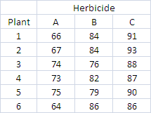
Sample Data From 3 or More Groups
Frequently, more than a single separation of a relevant data set is involved resulting in comparisons across more than two groups.
When we move into multiple comparisons for more than two groups, the approaches we have considered to this point need to be modified to be successfully extended.
Consider an example where several different herbicide mixtures (A, B, & C) are to be evaluated for their effect on plant growth. Six plants were assigned at random to receive one of these herbicides during the study period. The data are the additional growth for each plant over the study period (in cm).
Research Hypothesis: H₁: μ_{i} ≠ μ_{j}, for some i ≠ j,
i,j = A, B, C
Null Hypothesis: H₀: μ_{A} = μ_{B} = μ_{C}
Test Statistic: F = S²_{Between}/S²_{Within}
Provided data are normally distributed & variances within groups are equal
Null Distribution: F_{(nG-1, n-nG)} (where n_{G}=3, the number of groups)
Decision Rule: Reject H₀ if F > F_{(nG-1, n-nG, 1-α)}
Decision: F = S²_{Between}/S²_{Within} >
= 571.6/14.3
= 39.97 > F_{(2,15, 0.95)} = 3.68,
so Reject H₀ in Favor of H₁.
Conclude: The average additional growth is different with respect to the different herbicide applied.
So why this test statistic and how is it specifically determined from the data?

Slide 31
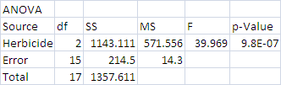
Sample Data From 3 or More Groups
When more than two groups are involved and we are interested in determining if the respective populations from which the samples within each have been acquired have different population mean values, then the approach most often utilized is Analysis of Variance.
The approach, often abbreviated as ANOVA, simply compares the variation between group averages to the variation of the results within groups. Hence, the name refers to “variance” when it is actually an evaluation of the group means.
The concept is that if there are no differences between the population means from which the respective sample groups have been obtained, then all the data is from essentially the same population, and the group averages* would not be expected to vary any more than the individual data values. The “*” is included to note that these group averages need to be properly scaled … why?
The CLT tells us that Var(X-bar) = σ²/n, where σ² is the variance of individual results and n is the number of individual results comprising the sample, so need to multiply Var(X-bar) by n for it to have the same variation as individual results.
The most popular means of outlining an Analysis of Variance is through use of an ANOVA table:
Herbicide Data
In general,
Source: Identifies the Factors involved, last two rows are virtually
always “Error” and “Total”
df: Respective Degrees of Freedom for each Source of Variation,
for a 1-way ANOVA df_{Factor} = n_{G} -1, where n_{G} = number of groups
SS: Sums of Squares for each Source of Variation, for a balanced
1-way ANOVA, these are:
Factor: n_{W}∑_{i=1 to nG} (Y_{i}-bar – Y-bar)², n_{W} = number within each group
Error: ∑_{i=1 to nG}∑_{j= 1 to nW}(Y_{ij} – Y_{i}-bar)²
Total: ∑_{i=1 to nG}∑_{j=1 to nW}(Y_{ij} – Y-bar)², SS_{Total} = Sum of all rows above
MS: Mean Squares for each Source of Variation, MS_{i} = SS_{i}/df_{i}, for all
rows of the table, except the “Total” row.
F: F statistic(s), generally MS_{i}/MSE, where MSE = MS for “Error” row
p-Value: Respective p-Values for each F statistic
Note: MSB = n_{W}*S_{B}², where S_{B}² = Variance of the
Group Averages, and
MSW = S_{W}², where S_{W}² = Average of the
Within Group Variances
If no difference in group means, these are both estimators of σ², the population variance.

Slide 32
Sample Data From 3 or More Groups
Note that the implied statistical model involved here is a little more involved than the simple
Mean + Error model outlined previously. The model implied in the simple, balanced 1-way ANOVA situation of the previous examples is:
Y_{ij} = μ + α_{i} + ε_{ij}, i = 1, …, g (the number of groups) and j = 1, …, m (number of results for each group)
where Y_{ij} = the jth result from the ith group,
μ = an overall mean level for the data,
α_{i} = an offset for the mean level of the ith group from the overall mean (so μ_{i} = μ + α_{i}),
ε_{ij} = random error term
The assumptions for this model include Σ_{i=1 to g} α_{i} = 0 and ε_{ij} ~ NID(0, σ²).
So … when we reject H₀: all μ_{i} equal in favor of H₁: μ_{i} ≠ μ_{j} for some i ≠ j, the result is still unsatisfactory. Why?
Of course, it does not provide any idea as to which group means are likely to be different, let alone how much different they might be.
For single and two-sample problems, the tool used to address the “How Much?” question was a confidence interval. A similar approach can be used with 3 or more groups, but there is a need to be careful. Why?

Slide 33
Sample Data From 3 or More Groups
For g groups, there are effectively
g*(g-1)/2 comparisons to be made.
As more intervals are required and the likelihood of all intervals containing their respective parameters can be much lower than the stated confidence level for any one interval.
For g = 3, there are only 3 comparisons to be made, but if we use 90% confidence level for all the relevant intervals, then the probability of one not including the true μ_{i} – μ_{j} value is relatively large (~27% = 1 - .9³).

Slide 34
Sample Data From 3 or More Groups
There are a variety of approaches to address this issue and these are all described in some detail in the text (see Chapter 9). Effectively, they all are of the form:
Y-bar_{i} – Y-bar_{j} ± M(α)*Std Deviation of (Y-bar_{i} – Y-bar_{j})
where the Std Deviation(Y-bar_{i} – Y-bar_{j}) = Sqrt(2*MSE/m), with MSE = Mean Square Error
from the associated ANOVA table, and m = number of results for each group.
The differences between the most widely used approaches involve the multiplier M(α).
Approach | Multiplier | Comment
Fisher’s Least Significant Difference (LSD) | t_{(N-g,1-α/2)} | The multiplier is the upper α/2 percentile point of a Student’s-t distribution with N-g degrees of freedom, where N = total number of observations, and g = the number of groups, only applied after rejecting H₀: all means equal via F test. These intervals do not protect against experiment-wide error, but the rejection via the F test implies at least one group mean is different from the others.
Tukey’s Honest Significant Interval (HSI) | q_{(g,} _{N-g)}/sqrt(2) | Requires a table for the q(.) values (Table 10 in your text has values for α =0.01 & 0.05). These are critical values for the studentized range statistic, which protects experiment-wide error.
Bonferroni Confidence Intervals (BCI) | t_{(N-g, 1-α/[g(g-1)])} | The multiplier is the upper α/[g(g-1)] percentile point of a Student’s-t distribution with N-g degrees of freedom. The divisor here protects for experiment-wide error.

Slide 35
Sample Data From 3 or More Groups
Regardless of which approach is used, graphically displaying the results can become complicated, especially as the number of groups (g) increases.
One way to overcome this is to plot each group mean (Y-bar_{i}) ± half the width of the respective interval being used. On such a plot, and intervals that do not overlap indicate differences between those group means.
Be careful not to use these intervals as confidence intervals for the specific means. The intervals being plotted will be narrower than intervals with the same confidence for each specific group mean.
For the herbicide example, the respective half-width intervals appear below (α = 0.05):
Clearly, in this case, all the group means are different, with Herbicide C providing the most growth and Herbicide A the least. Actually, Herbicide A in this instance was a control group (ie, no herbicide).

Slide 36
Sample Data From 3 or More Groups
What about groups with unequal variances?
Recall that the 1-way ANOVA procedure assumes similar variation for each group.
Can we test to see if this is valid?
One test is to simply consider the ratio of the largest within group variance to that of the smallest (Hartley’s F_{max} Test):
F_{max} = S_{max}²/S_{min}²
Critical values for this test appear in Table 12, for α = 0.05 and 0.01. Each table is entered with the number of groups involved (Table columns) & the common group sample size less 1 (ie, n_{W} – 1, for Table rows). Note this test was developed assuming equal sample sizes for each group, but if they are close, then can use something like a harmonic mean of the n_{i} values.
Another test for equal variances would be the Brown-Forsythe-Levine (BFL) test. This test essentially involves a 1-way ANOVA of a newly constructed variable v_{ij} = |y_{ij} – m_{i}|, where m_{i} = median of the results for the i^{th} group. This can involve some computations, but is available in many software packages.
If no such package is available, then the BFL test statistic is calculated as:
L = {∑_{i=1 to g} n_{i}(V-bar_{i} – V-bar)²/(g – 1)} / {∑_{i=1 to g} ∑_{j=1 to ni} (v_{ij} – V-bar_{i})²/(N – g)},
where g = number of groups and N = ∑_{i=1 to g} n_{i}; which is simply MSB_{v}/MSE_{v}, so the critical value is determined from the upper tail of an F_{g-1,N-g} distribution. Note L can be evaluated for unequal group sizes.
This test is preferred also because it is less sensitive to departures from normality. Although the Hartley test is more powerful when the data is indeed normal, it is usually more desirable to keep the Type I error rate low in these tests, and this can become large for the F_{max} test as conditions depart from the basis for its development (ie, equal group sizes and normally distributed data). Also, a special table of critical values is unnecessary for the BFL test.

Slide 37
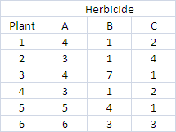

Sample Data From 3 or More Groups
Herbicide example:
Raw Data
Research Hypothesis: H₁: Population variances not all equal.
Null Hypothesis: H₀: Population variances all equal.
Test Statistic: L
Null Distribution: F_{g-1,N-g}
Decision Rule: Reject H₀ if L > F_{(2,15,0.95)} = 3.682
Decision: L = 2.1961 < 3.682; hence, Fail to Reject H₀
Conclusion: Insufficient evidence in the data to indicate population variances are not all the same, or at least nearly the same (at significance level 0.05, p-Value ≈ 0.146).
Absolute Deviations from Median
Note that F_{max} = S_{A}²/S_{C}² = 3.182,
which is less than the corresponding Table 12
critical value for 3 groups, group size = 6, and
α = 0.05 of 10.8. Hence, this result is consistent
with the BFL test result.
ANOVA for above

Slide 38
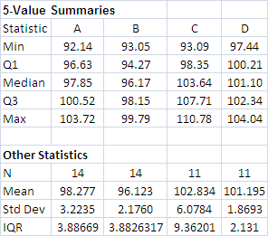
Sample Data From 3 or More Groups
Workshop 1 Example:
Research Hypothesis: H₁: Population variances not all equal.
Null Hypothesis: H₀: Population variances all equal.
Test Statistic: L
Null Distribution: F_{g-1,N-g}
Decision Rule: Reject H₀ if L > F_{(3,46,0.95)} = 2.807
Decision: L = 8.893 > 2.807; hence, Reject H₀
Conclusion: The population variances are not all the same (at significance level 0.05, p-Value ≈ 0.000093).
So, the σ_{i}² are not all equal, but how are they different?
There are several possible ways to handle this.
Probably the most technically correct would be to compare all six possible ratios of pairs of S_{i} using Bonferroni-type confidence intervals based on F-distributions.
However, providing simple confidence intervals for each group might also suffice and be easier to communicate.
The real concern is what if we are most interested in differences in group means? The standard ANOVA procedure assumes equal variances within groups, but if evidence to contrary, then …
1) Could consider nonparametric approach
2) Could “normalize” the data (eg, divide by S_{i} within each group)
3) Perhaps a transformation of some kind (eg, ln(y))

Slide 39
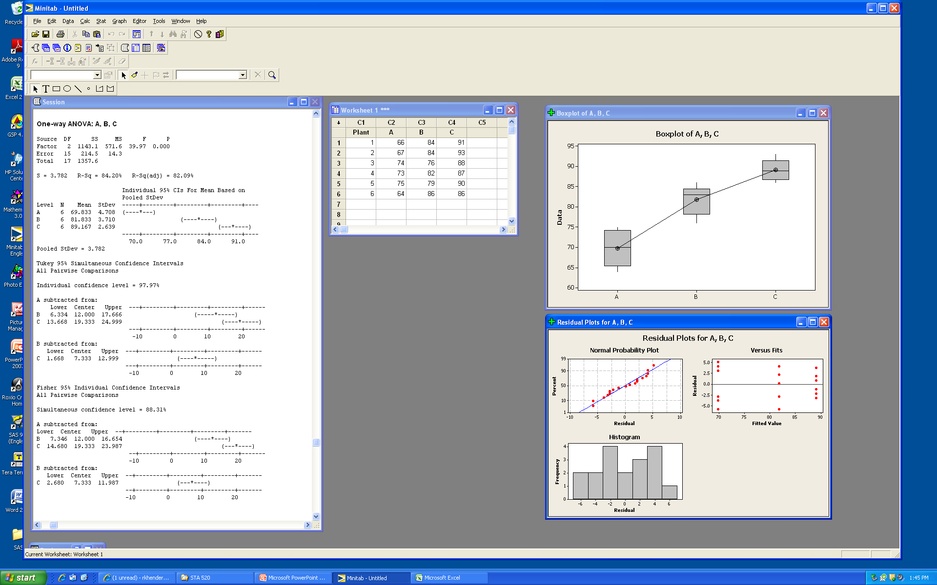
Sample Data From 3 or More Groups
MINITAB: Stat → ANOVA → One-Way (Unstacked)
Comparisons button: Chose Tukey & Fisher
Graphics button: Chose Box Plots & 3 in 1 Residual Plots

Slide 40
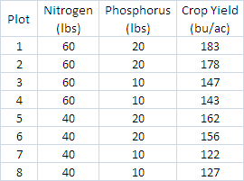
Two-Way Analysis of Variance
The Herbicide data was analyzed with what if referred to as a One-Way Analysis of Variance.
It is only a One-Way analysis because the groups are only identified in a single way (ie, by the type of Herbicide used).
Often, groups are identified in more than a single way. Consider, for example, the evaluation of Crop Yield for plots treated with different amounts of Nitrogen and Phosphorus:
Note that the implied statistical model involved here is a little more involved than the One-Way ANOVA model.
The model implied in the simple, balanced 2-way ANOVA situation present in this example is:
Y_{ijk} = μ + α_{i} + β_{j} + ε_{ijk},
with i = 1, …, a (the number of levels for Factor A),
j = 1, …, b (the number of levels for Factor B),
and k = 1, …, m (number of results for each group)
where Y_{ijk} = the kth result from group (i, j),
μ = an overall mean level for the data,
α_{i} = an offset for the mean level when Factor A = i
from the overall mean
β_{j} = an offset for the mean level when Factor B = j
from the overall mean (so μ_{ij} = μ + α_{i} + β_{j}),
ε_{ijk} = random error term
The assumptions for this model include Σ_{i=1 to a} α_{i} = 0,
Σ_{j=1 to b} β_{j} = 0, and ε_{ijk} ~ NID(0, σ²).
Note that each plot is now classified two ways: Amount of Nitrogen applied & Amount of Phosphorus applied.
Now we have two factors or treatments to consider rather than just one.

Slide 41
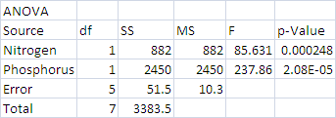
Two-Way Analysis of Variance
A formal hypothesis test is generally built around the relevant ANOVA Table.
Research Hypothesis: H₁: μ_{ij} ≠ μ_{i’j’}, for some i ≠ i’ and/or j ≠ j’, i,i’ = 1,…,a, j,j’ = 1, …, b
Null Hypothesis: H₀: μ_{ij} = μ_{i’j’}, for all i,i’ = 1,…,a and j,j’ = 1,…,b
Test Statistics: F_{A} = MSA/MSE & F_{B} = MSB/MSE
Provided data within groups are normally distributed & variances within groups are equal
Null Distributions: F_{(a-1, abm-a-b+1)} & F_{(b-1, abm-a-b+1)} (where a=2 & b=2, the number of levels for Factors A &B, respectively)
Could have single Test Statistic:
F_{All} = [(SSA + SSB)/(a+b-2)]/MSE
ANOVA Table
Null Distribution:
F_{All} ~ F_{(a+b-2,abm-a-b+1)}
Source | df | SS | MS | F
Factor A | a-1 | SSA = bm∑_{a}(Y_{i}-bar – Y-bar)² | MSA = SSA/(a-1) | F_{A} = MSA/MSE
Factor B | b-1 | SSB = am∑_{b}(Y_{j}-bar – Y-bar)² | MSB = SSB/(b-1) | F_{B} = MSB/MSE
Error | abm-a-b+1 | SSE = ∑_{a}∑_{b}∑_{m}(Y_{ijk} – Y_{i}-bar – Y_{j}-bar + Y-bar)² | MSE = SSE/(abm-a-b+1)
Total | abm-1 | TSS = ∑_{a}∑_{b}∑_{m} (Y_{ijk} – Y-bar)²
Decision Rule: With α = 0.05,
Reject if either F statistic is larger than its corresponding 95th percentile point
Decision Rule: Reject if
F_{All} > F_{(a+b-2,abm-a-b+1,1-α)}
Decision: Reject H₀ since both F_{A} & F_{B} > 6.608
Conclusion: Application of Nitrogen and Phosphorus effects Crop Yield (p-Value < 0.00025)
Decision: Reject since F_{All} = 161.75 > F_{(a+b-2,abm-a-b+1,0.95)} = 5.786
Conclusion: Same
(p-Value = 0.000029)

Slide 42
Two-Way Analysis of Variance
Similar to most hypothesis tests, a reject decision provides a conclusion that leaves unanswered questions. For the Crop Yield data, the conclusion is that application of Nitrogen and Phosphorus impacts Crop Yield; however, it is not clear how they do so.
Again, we resort to a suitable multiple comparison technique to compare the group averages.
Note that intervals below are half-width confidence intervals so those that do not overlap suggest significant differences in corresponding population means.
These intervals were obtained by first generating the actual Bonferroni confidence intervals for the difference between any two of the respective group means:
(Y_{ij}-bar – Y_{i’j’}-bar) ±
t_{(abm-a-b+1, 1-α/[ab*(ab-1)])}*sqrt(2MSE/m)
Then take the half-width of these intervals (ie, the second row above divided by 2) and add and subtract it from each of the respective group means:
Y_{ij}-bar ± (1/2)* t_{(abm-a-b+1, 1-α/(ab*[ab-1])}*sqrt(2MSE/m)
Note that this is ~70% (sqrt(2)/2) of the width of a Bonferroni confidence interval for μ_{ij} alone.
It appears Yield increases with application of both chemicals (~1bu/ac per 1lb N & ~3.5bu/ac per 1lb P).

Slide 43
Two-Way Analysis of Variance
Another type of plot often used in Analyses of Variance is the Profile Plot, especially when at least one of the group identifiers is continuous in nature. Both of these identifiers (Amt of N & Amt of P) are continuous in this case.
Note that this plot displays the effect of applying additional Phosphorus (P) for each specific application of Nitrogen (N).
The form of the relationship between Crop Yield and Phosphorus is depicted as linear in nature since only two levels of Phosphorous application were evaluated.
The lines being virtually parallel is an indication that the purely additive two-way model evaluated is appropriate.
However, what happens if we arbitrarily subtract 60 bu/ac Yield from the observed values for the plots receiving 60 lbs of Nitrogen and 20 lbs of Phosphorus?
Clearly, the profile plot changes significantly.
What about the ANOVA?

Slide 44
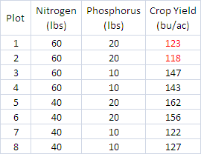
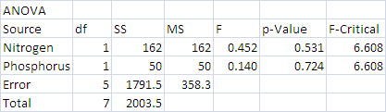
Two-Way Analysis of Variance
Data
Analysis of Variance Table
What happened?!?
Nothing appears significant any longer,
1) Both F statistics are < 1, with
p-Values > 0.5,
2) All multiple comparison intervals
overlap, and
3) The MSE ~35X larger than before
(which is the root of the problem),
but we did not change the within group variation at all!

Slide 45
Two-Way Analysis of Variance
The problem here is that the simple two-way model, which is purely additive in nature is no longer appropriate. The departure from parallel for the lines in the Profile Plot indicate the need for a multiplicative term in the model. This is the role of what is called the Interaction term which needs to be added to the original simple additive model.
The new, and more general two-way, balanced ANOVA model including Interaction is:
Y_{ijk} = μ + α_{i} + β_{j} + αβ_{ij} + ε_{ijk},
with i = 1, …, a (the number of levels for Factor A),
j = 1, …, b (the number of levels for Factor B),
and k = 1, …, m (number of results for each group)
where Y_{ijk} = the kth result from group (i, j),
μ = an overall mean level for the data,
α_{i} = an offset for the mean level when Factor A = i from the overall mean
β_{j} = an offset for the mean level when Factor B = j from the overall mean
αβ_{ij} = a multiplicative effect for Factors A and B for group (i, j) (so, now μ_{ij} = μ+α_{i}+β_{j}+αβ_{ij}),
ε_{ijk} = random error term
The assumptions for this model include Σ_{i=1 to a} α_{i} = 0, Σ_{j=1 to b} β_{j} = 0, Σ_{i=1 to a}Σ_{j=1 to b} αβ_{ij} = 0, and ε_{ijk} ~ NID(0, σ²).

Slide 46
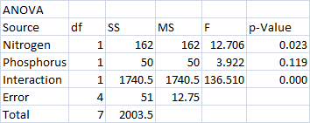
Two-Way Analysis of Variance
The New ANOVA Table including the accounting for Interaction is given as:
Source | df | SS | MS | F
Factor A | a-1 | SSA = bm∑_{a}(Y_{i}-bar – Y-bar)² | MSA = SSA/(a-1) | F_{A} = MSA/MSE
Factor B | b-1 | SSB = am∑_{b}(Y_{j}-bar – Y-bar)² | MSB = SSB/(b-1) | F_{B} = MSB/MSE
Interaction | (a-1)(b-1) | SSAB = m∑_{a}∑_{b}(Y_{ij}-bar – Y_{i}-bar – Y_{j}-bar + Y-bar)² | MSAB = SSAB/[(a-1)(b-1)] | F_{AB} = MSAB/MSE
Error | ab(m-1) | SSE = ∑_{a}∑_{b}∑_{m}(Y_{ijk} – Y_{ij}-bar)² | MSE = SSE/[ab(m-1)]
Total | abm-1 | TSS = ∑_{a}∑_{b}∑_{m} (Y_{ijk} – Y-bar)²
The Error df and SS are separated into two parts, one of which captures the effect of the Interaction element of the model.
Note that testing in mutli-way ANOVA situations proceeds with evaluation of the highest order interaction.
If it is significant, indicating a multiplicative aspect to the model, then the main effects associated with this interaction are not evaluated, but are considered necessary to properly support the significant interaction.

Slide 47
Two-Way Analysis of Variance
The profile plot was the origin of this evaluation of interaction, which is highly significant here since the profiles actually trend in different directions. However, any departure from parallel suggests the potential for significant interaction to be involved.
Bonferroni comparisons indicate a significant difference between the plots with both N and P at their lowest & highest values and the plots where one is high and the other low.

Slide 48
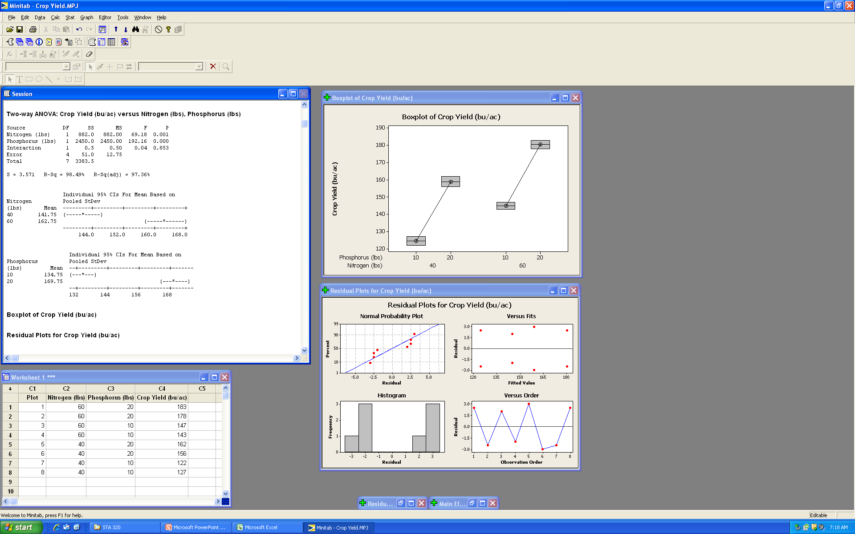
Two-Way Analysis of Variance
MINITAB: Stat → ANOVA → Two-Way
Rows: Nitrogen, Columns: Phosphorus
Graphs button: Chose 4 in 1 & Box Plots
NOTE: Two-Way automatically includes an Interaction Effect in the Analysis

Slide 49
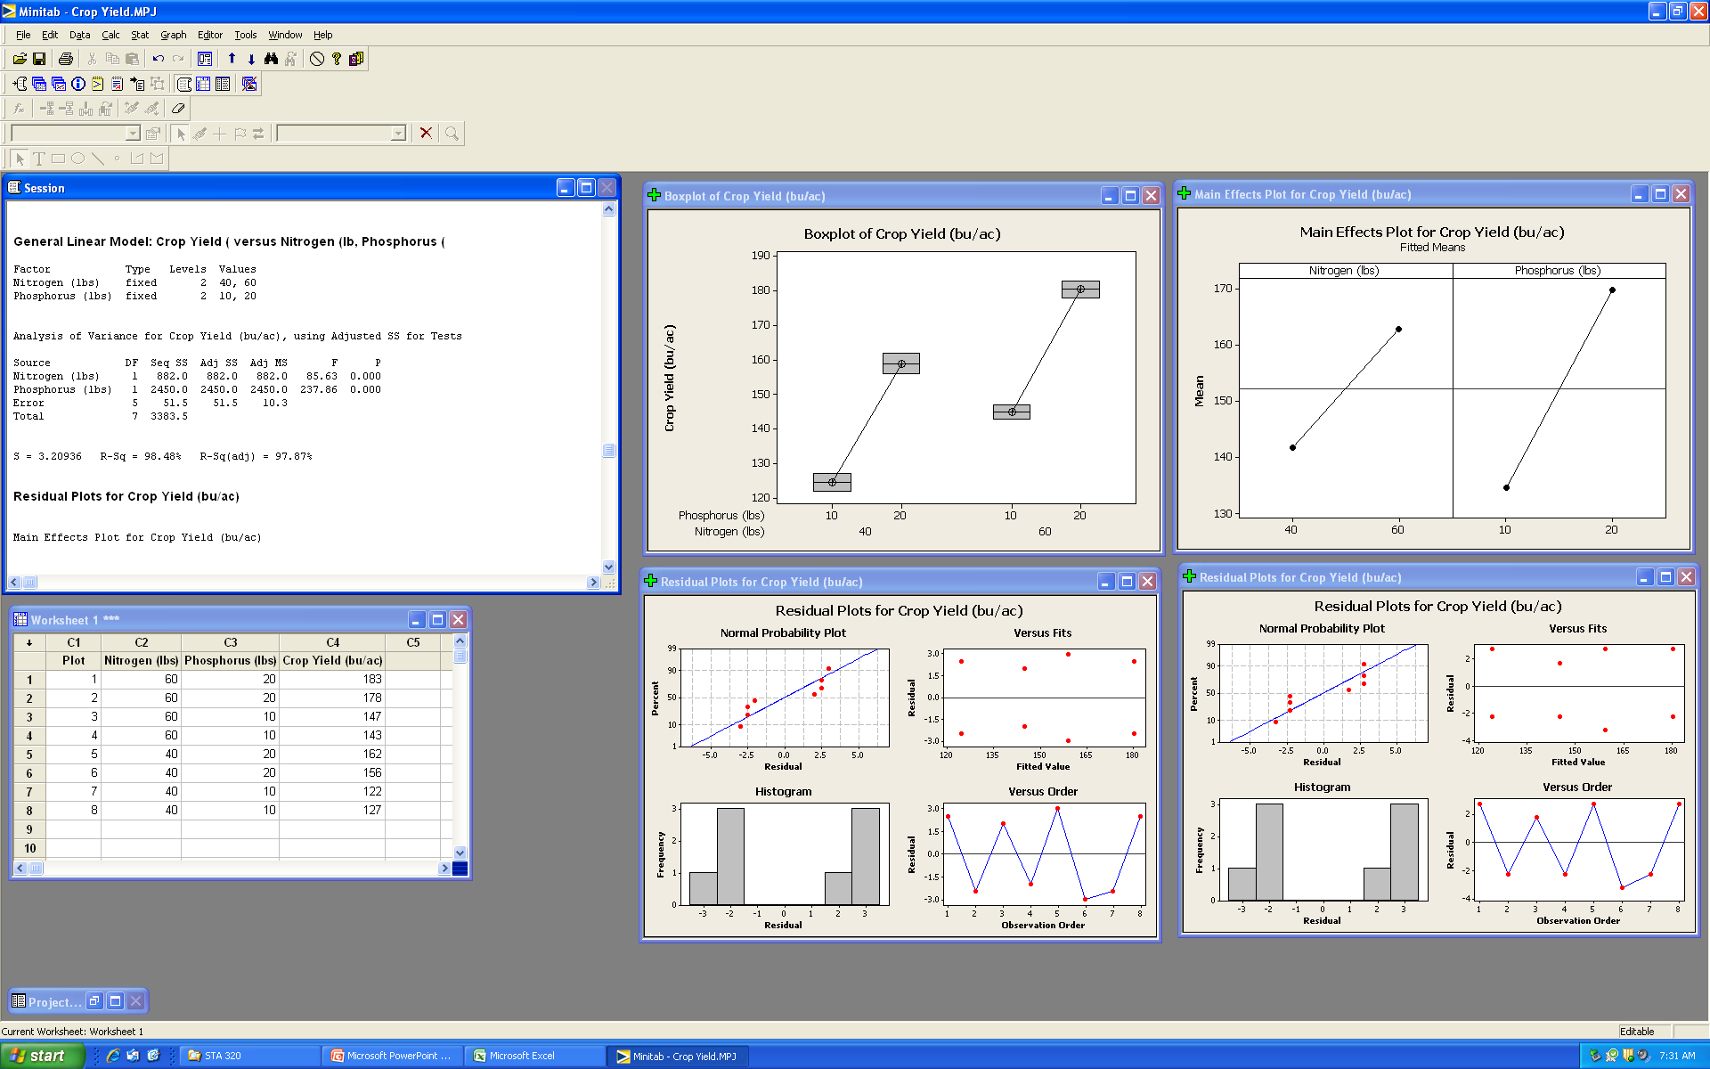
Two-Way Analysis of Variance
MINITAB: Stat → ANOVA → General Linear Model
Response: Crop Yield
Model: Nitrogen Phosphorus
Factor Plots button: Chose Main Effects (N & P)

